Slide 1

How meta transactions can enhance user onboarding
Lakhdar SLAIM - Rockside

Slide 2
Myself
Lakhdar SLAIM
Backend developper
3 months at Rockside (and on the Blockchain)
Also… huge fan of rap

Slide 3
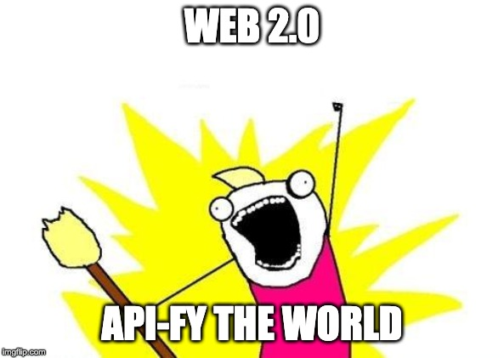

Slide 4
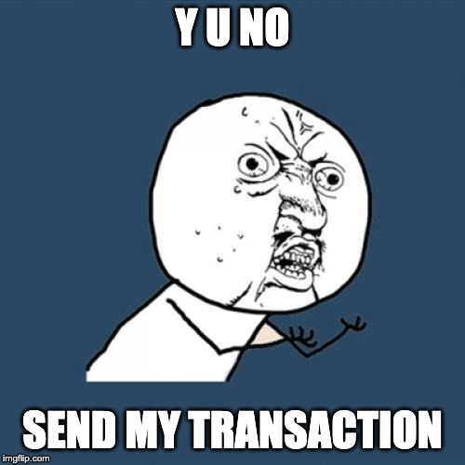

Slide 5
Demo App
Le toca, le pavot, l'avocat, c'est pas vos caveaux, c'est ma vocation
Sam’s - PLS (feat. Sofiane)
French rap can be… hard to understand.
Let’s develop a community that helps understand and interpret rap lyrics

Slide 6
What do I want ?
A web-app where users can :
Ask the community to explain lyrics
Explain lyrics for other users
Reward other users for good explanations
My users should not be aware of private keys, gas or node connection.
They just don’t care.

Slide 7
Ethereum 101
Transaction is a value transfer that can contain data.
  You can send ether to another address
  You can call a function that will be executed on-chain
Transactions are ordered with a nonce
  Must be unique
  Is incremented at each transaction an address make
  BAD THINGS happen if you make a mistake
Smart contract is code executed on-chain
  ERC are standardized smart contract interfaces

Slide 8
What do I want ?
A smart contract that represents the money on the platform
Each user gets money on registration
Each user can transfer money to other users

Slide 9
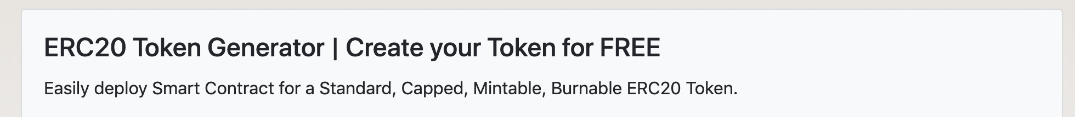
The journey begins
Keep It Simple : Create and deploy an ERC-20 using a website
Woohoo ! The “WSH” is born !
I can send WSH to new users, “easily”...

Slide 10
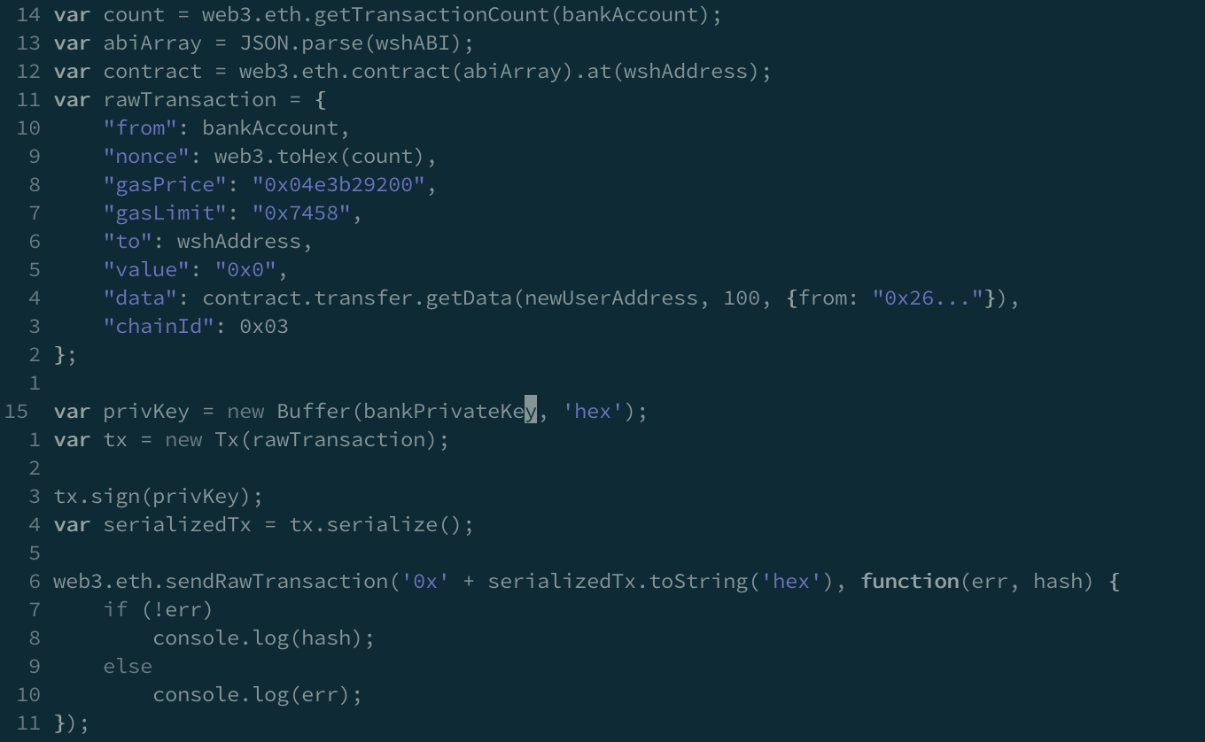

Slide 11
Wait a minute...
Users can’t send WSH to each other…
But my users don’t even know about blockchain.
What are the alternatives ?

Slide 12
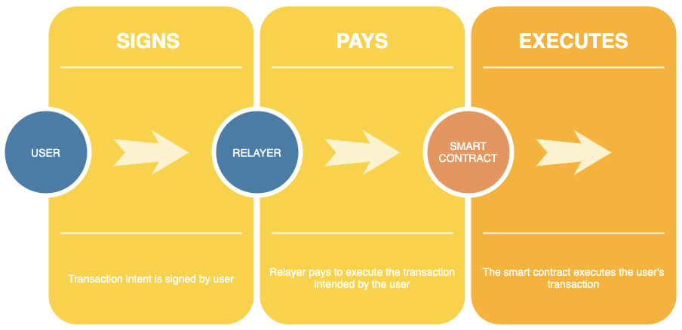
Meta-transactions
Transaction by user executed by a relayer who provides the gas for execution
Off-chain
On-chain

Slide 13
Implementation
User signs an intent of transaction : User A wants to send n WSH to user B
Our bank creates a transaction that wraps the intent of user A and the proof user A actually asked for this transaction
Our meta transaction smart contract verifies that user A indeed asked for the transaction and executes the transaction

Slide 14
Implementation details...
Already good implementations of meta-transactions :
Argent relayer module
Bouncer proxy of Austin Griffith
and more...

Slide 15
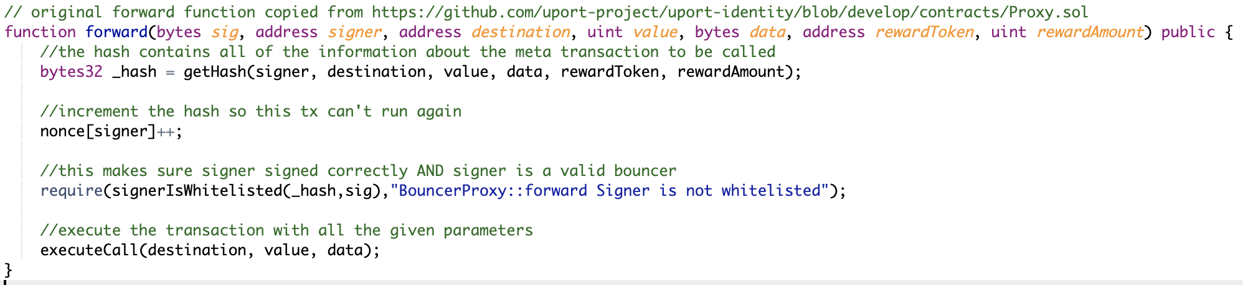
Implementation details...

Slide 16
Let’s recap
User isn’t aware of anything. I can create a private key for him and only show him his WSH balance.
User can transfer WSH to other users and reward them for good explanations.
I still have complex code, but hey my user experience is fine!
I also manage a relayer that has complex code and infrastructure.

Slide 17

Solution
Like Stripe or Paypal for online payment, Rockside API manages the complexity of the interactions with Blockchain, exposing simple and secure services to the developers.
Your Users
Your Application
Rockside API
Blockchain Network
Key (Signature)
High Volume (Nonce)
Transaction fee (GAS)
Network access (Nodes)
Analytics and Monitoring
Compliance & Regulation

Slide 18
How can it be done ?
Entity as an “Identity” on Blockchain
  Key can be stored be the client or by Rockside
  Nonce is managed by Rockside
  Gas is sponsored by Rockside
Use Rockside RPC endpoint to create transactions

Slide 19
Problems we faced
Nonce management
Key management

Slide 20
Conclusion

Slide 21
Keep in touch
Mail : lsl@rockside.io
Website : rockside.io
Docs : docs.rockside.io
Open beta, ask me for API key !

