Slide 1
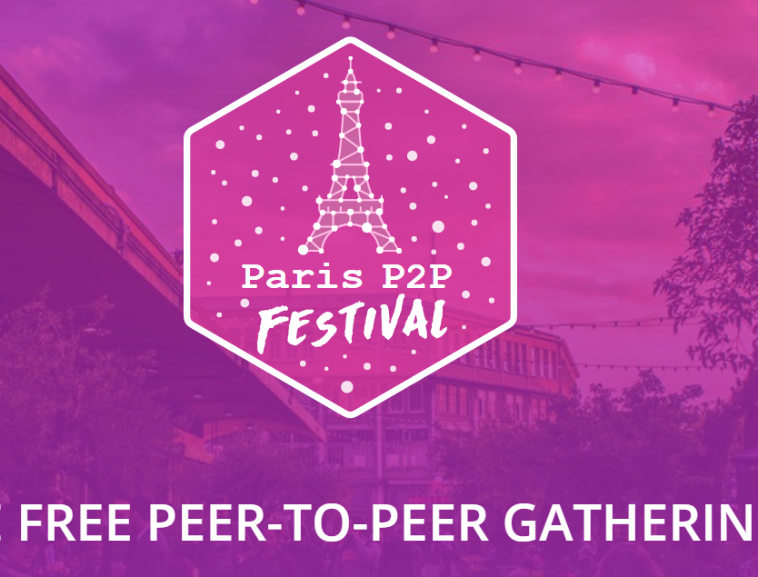
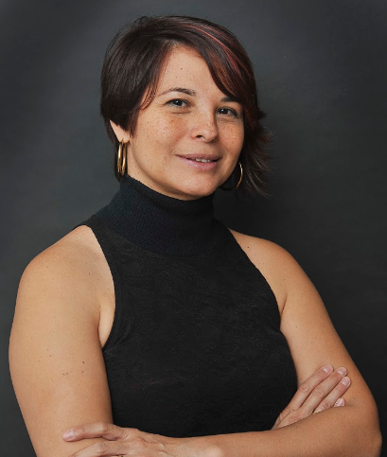

Twitter lilicarrillof
LinkedIn carrilloliliana
Notes:
Hi everyone, I am Liliana, a board member of the P2P Foundation

Slide 2
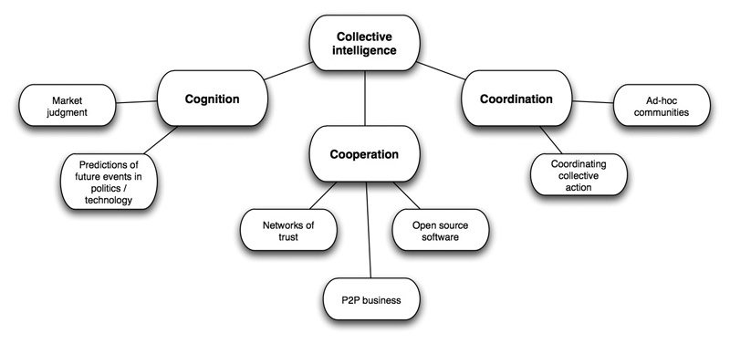
Liliana Carrillo
Researcher Entrepreneur
Collective Intelligence
Liliana Carrillo
From Artificial Intelligence to Collective Intelligence
From Computer Science to other sciences: social, educational political
From Waterfall project management to Agile Project Management
Notes:
My contribution to collective intelligence is mostly focused on ‘Coordinating Collective Actions’. But there are more ways to support this process, like creating Open Source Software, or P2P businesses. So, I invite you to be part of the Whole.

Slide 3
P2P and the Commons
The School as example
Governance at school
School resources
P2P learning and Commons
Urban Commons
Challenges

Slide 4

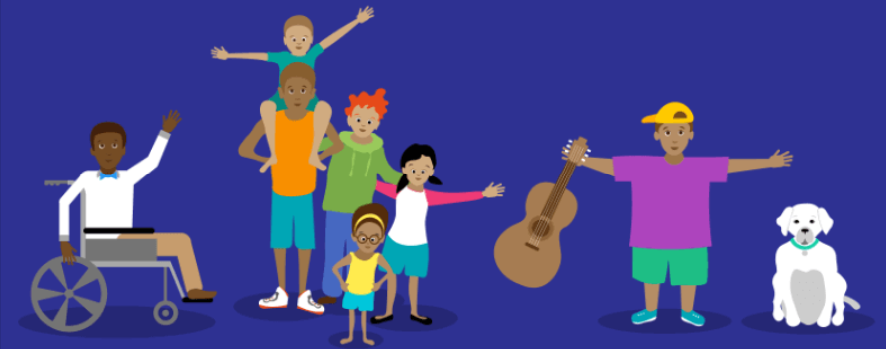
Governance at school
www.self-directed.org/sde
Notes:
SDE, kids make the rules, Sudbury schools, SummerHill, Agile Learnig Centers

Slide 5
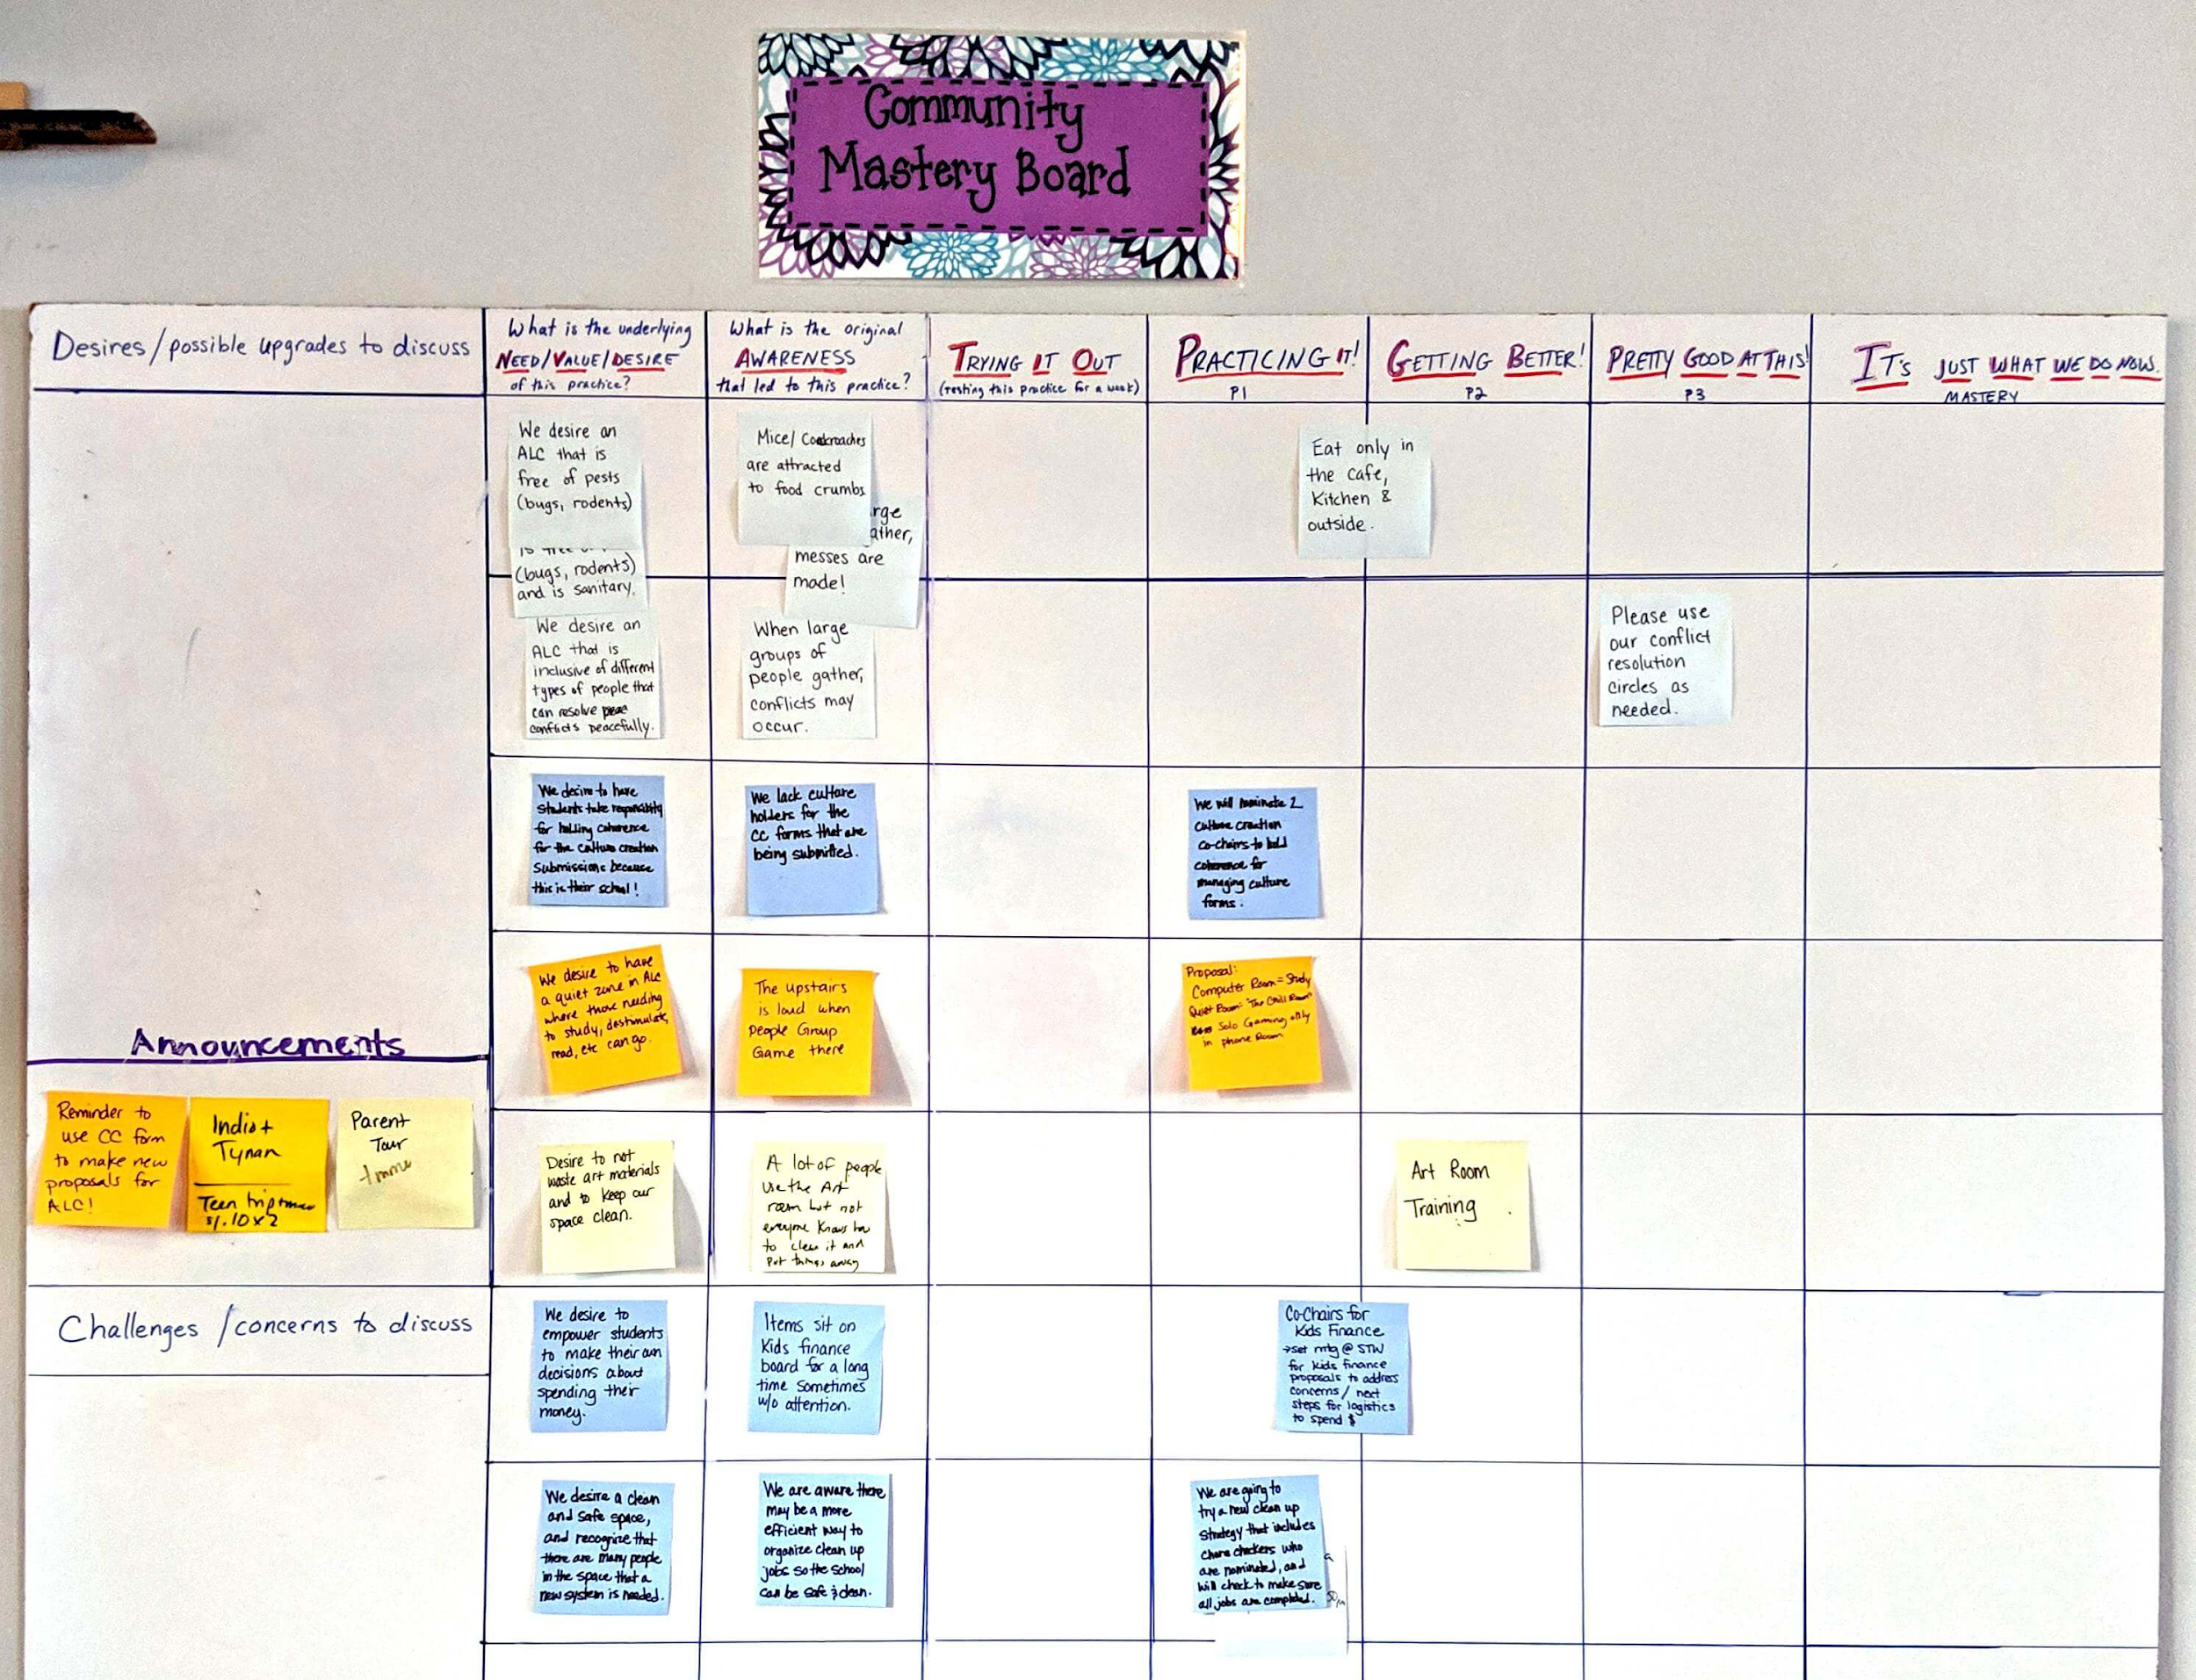


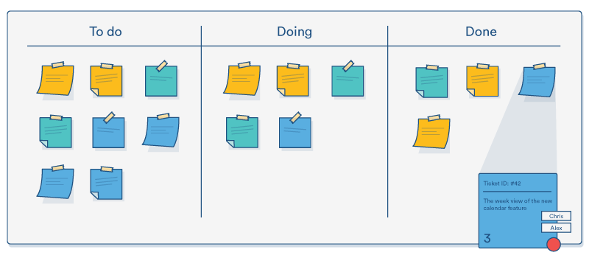
ALC Community Mastery Board
Governance at school
Notes:
There is a school meeting, direct democray, every child has a vote, a saying on the decisions. Teacher do not make the rules, their vote counts as one of the kids. System designed for equality. Kids are Adults have equal vote. Facilitators. In such a freedom, methods are used to support the governance process. When there is total freedom, there is still the need to get organized.

Slide 6

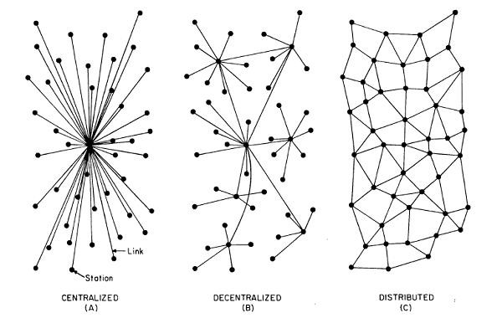


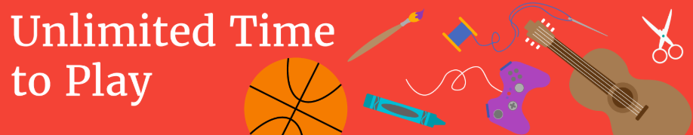
School resources
Notes:
one classroom with computers – dictatorship
One computer room for the whole school, all teachers coordinate and dictate to the kids the agreements
Kids organize how to manage the computer room, how to share the computers and the space. Computer example at sudbury ghent. Freedom and organization.

Slide 7

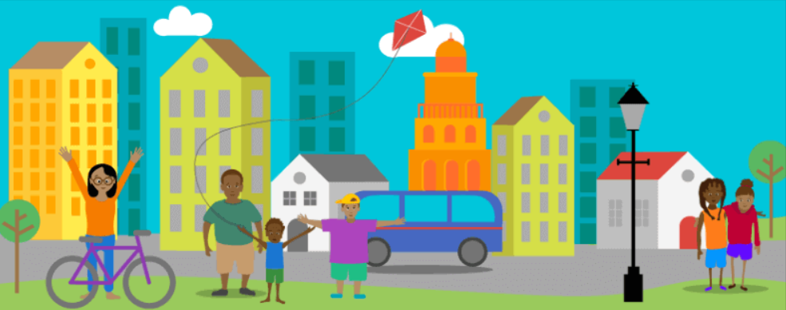
P2P and Commons at School
Notes:
Design of the system – Teacher/School as a Partner/Facilitator. Relation between participation, open democracy, and opening the space for common initiatives to happen.
Design the system diferently, in this case allowing peer-to-peer learning and learning to happen all the time, the space for common management of resources is open.

Slide 8

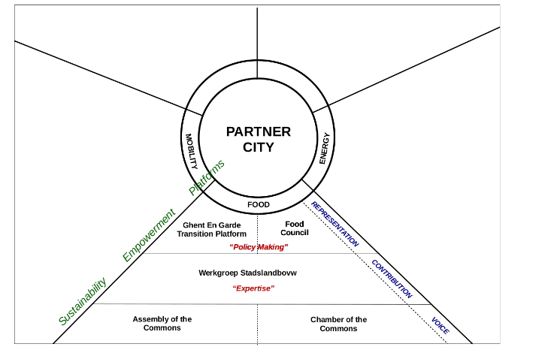
Urban Commons
Notes:
8
In the same way, when cities are open to co-design, they become a partner/facilitators
Citizens have a saying, a voice, working groups can be formed and policy making happen, initiatives like ghent en garde in Ghent for Food policy at city level

Slide 9
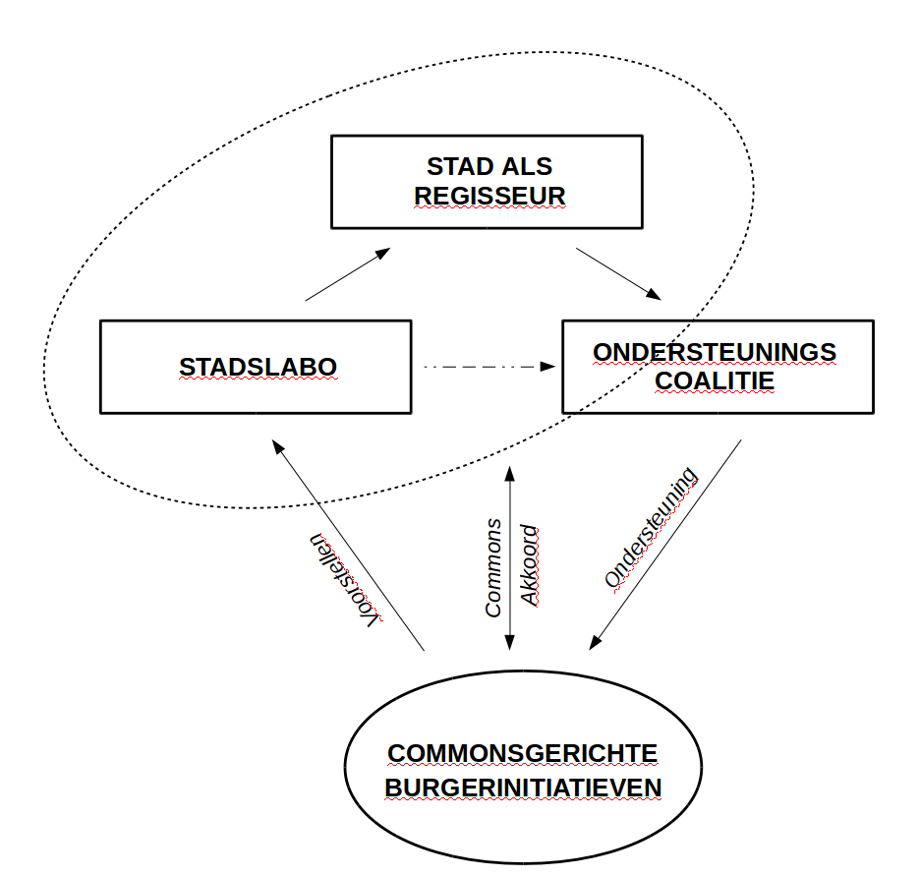
The city
Notes:
9

Slide 10
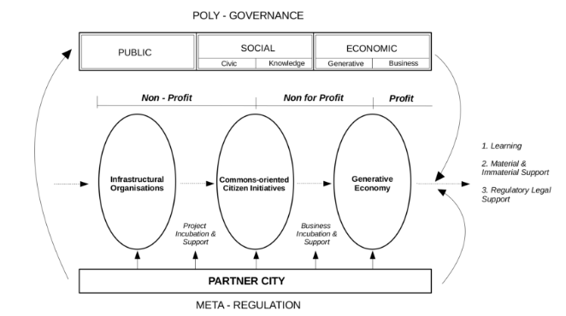
The city
Notes:
10

Slide 11

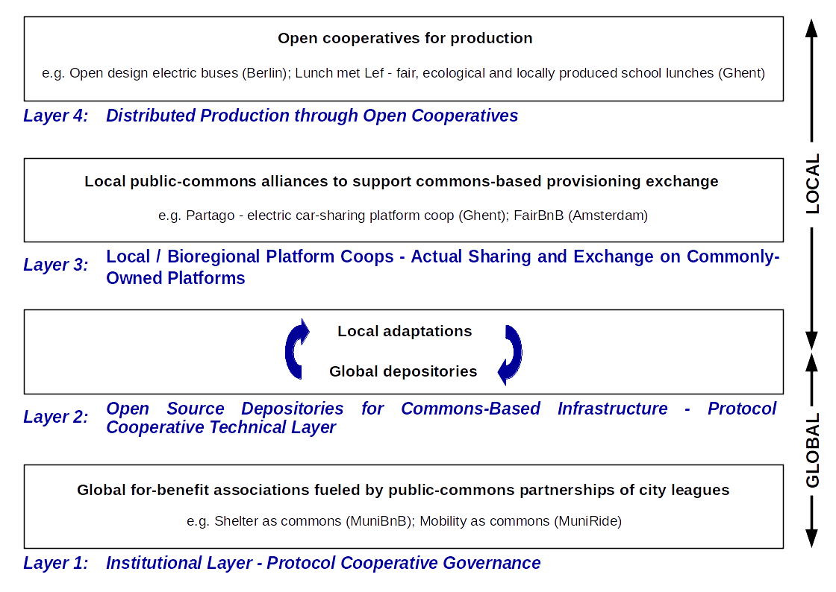
Challenges
Notes:
11
We have spoken of commons at local level, a school, a city,…..
To scale at global level, other layers are needed, more global infrastructures, global protocols. For example agile learning centers are relatively easy to launch in the US as local and national laws allow it. The situation is different in Europe. In Belgium for example Curriculum is impossed at National level. Students, schools do not have a saying on that. Then Other kind of work at a higher level is needed. New laws and institutions.

Slide 12
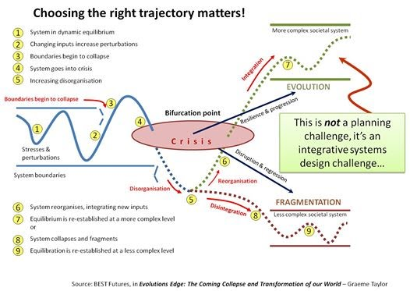
Challenges
Notes:
Many many many new, wonderful initiatives that do not talk to each other! Every company with a blockchain. We need to integrate systems, a design challenge.

Slide 13
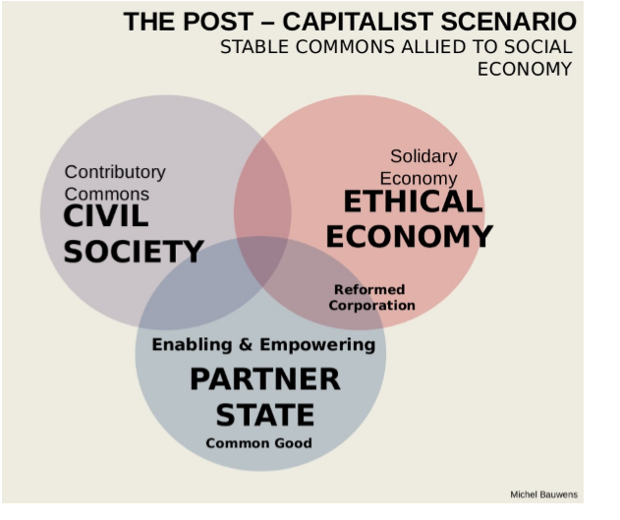
Challenges
Notes:
13
How do we design a post-capitalist system, the country as a partner? Here you see an example of Michel Bauwen.

Slide 14

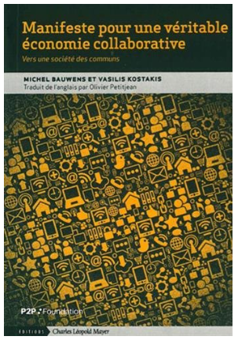
More information: https://p2pfoundation.net/
Notes:
14

Slide 15
THANKS YOU!
Twitter lilicarrillof
LinkedIn carrilloliliana

